Slide 1
Veterans Memorial Project Update
September 14, 2020
Notes:
MELISSA
Good Evening,
Mayor and Councilmembers, I am here tonight along with Mike Dardis, from Bloomington Remembers Veterans to provide an update on the Veterans Memorial Project.
This is a project that has been in the works for the past few years and we are excited to share the results of the Request for Qualifications process and next steps.
I will provide background on the project and will then hand it over to Mike who will review the 4 artists selected to submit a design for the memorial.

Slide 2




Project Timeline and Background
2016
Vietnam War 50th Anniversary Commemorative Partnership formed
2017
Veterans Memorial Planning begins
October
2018
Council grants approval of site on east lawn of Civic Plaza
November
2018
Bloomington Remembers Veterans, Inc. 501c3 formed
February 2020
Request for Qualifications (RFQ) Released
PAUSE
COVID 19
August
2020
4 Finalists Selected
October
2020
Design Selection
& Interviews
November
2020
Selected Design Presented to
City Council
January
2021
Fundraising Begins
Notes:
MELISSA
Collaboration between the City’s Community Outreach and Engagement Division, Facility Maintenance Division and Bloomington Remembers Veterans.
Construction of a Veterans Memorial came out of the work of the Vietnam War 50th Anniversary Commemorative Partnership, 3 year partnership the City joined in 2016.
In 2017, a Veterans Memorial was chosen as one of several initiatives of the commemorative partnership. Research done including site visits to memorials in other cities and potential park locations in Bloomington.
Planning committee selected east lawn of Civic Plaza as preferred site. Site features -adequate parking, a water feature, space to hold large events, and place for reflection. October of 2018, Council granted permission to continue to plan for a memorial to be constructed on the east lawn of Civic Plaza.
Also in 2018, was the formation of Bloomington Remembers Veterans Inc. as a 501c3 non-profit. Since that time the board and city staff have worked to release a request for qualfications (RFQ). This was originally planned for review in March but was delayed until August.
Next steps will include interviews of selected artists in October, back to City Council with chosen design and fundraising will begin in 2021.

Slide 3

Bloomington Remembers Veterans Inc.
BOARD MEMBERS:
Terry Collins, President
Michael Dardis, Vice President
Fran Stachour, Secretary
David Griffin, Treasurer
William Botsford, At Large Member
Richard Warren, At Large Member
Kate Blessing, At Large Member
Duane Brinkman, At Large Member
Notes:
MELISSA
Here are the Bloomington Remembers Veterans Board Members:
READ NAMES
In addition, there are also 9 other individuals who are organizational members.

Slide 4
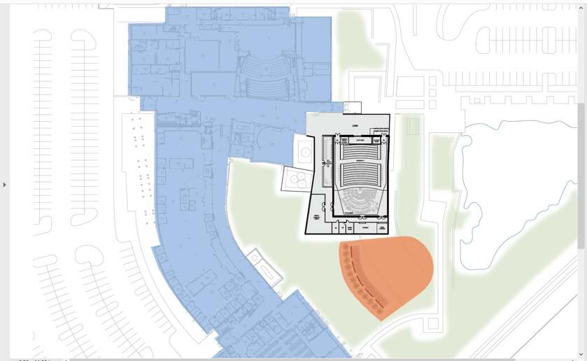
Veterans Memorial Site
Notes:
MELISSA
Here is the site map that was provided to artists for the Request for Qualifications.
It does account for a potential art center expansion in the future.

Slide 5
REQUEST FOR QUALIFICATIONS
Notes:
MELISSA
I will now take you through the RFQ process and then hand it over to Mike to review the selected finalists.

Slide 6
Review Committee Members
Dave Hanson, Assistant Facilities Superintendent
Melissa Wurst-Persaud, Community Outreach & Engagement Manager
Michael Dardis, Board member, Bloomington Remembers Veterans, Inc.
Fran Stachour, Board member, Bloomington Remembers Veterans, Inc.
William Botsford, Board member, Bloomington Remembers Veterans, Inc.
Don Wilson, Bloomington Remembers Veterans, Inc.
Les Fordahl, Bloomington Remembers Veterans, Inc.
Notes:
MELISSA
Here is a list of the review committee members. READ NAMES

Slide 7
Eligibility Criteria
Completion of 1 project (outdoor memorial or historic monument) in the past 10 years with a budget of at least $300,000.
Understanding or experience with installations that address the climate and ecosystem specific to Minnesota and the Bloomington site.
Notes:
MELISSA
The RFQ had two eligibility requirements.
READ EACH REQUIREMENT

Slide 8
RFQ Submissions
22 Submissions Received
12 Met Eligibility Criteria
Notes:
MELISSA
There were a total of 22 submissions received by artists and of those 22, 12 met the eligibility criteria.
The RFQ was published through the City’s bids and proposal webpage and through CAFE, which is a web based service for open art calls. This is the same service the City’s Creative Placemaking Commission and Artistry use.

Slide 9
Artists Selected for RFP
Notes:
MIKE BEGINS:
Mike Dardis will now share the 4 finalists with you and their sample submissions.
These finalists were selected using a jurying process based on 7 total points. 1 being the lowest and 7 being the highest.
After 3 rounds these 4 artists remained with the highest scores which were once again based on previous art/memorial experience with a budget of $300,000 or more and experience and knowledge of Minnesota’s climate and the Bloomington site.

Slide 10
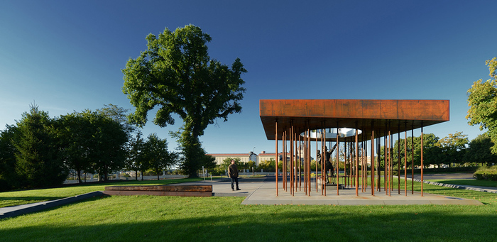
KELLY PTACEK
MN Fire Memorial
St. Paul, MN

Slide 11
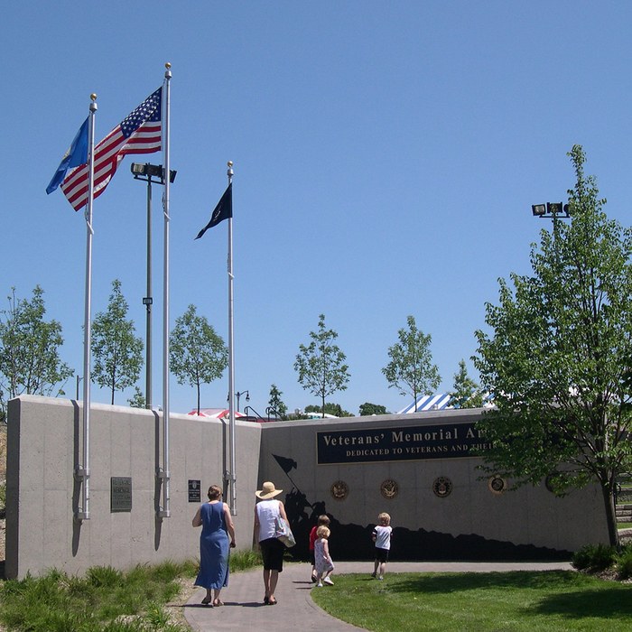
KELLY PTACEK
Veterans Memorial
St. Louis Park, MN

Slide 12
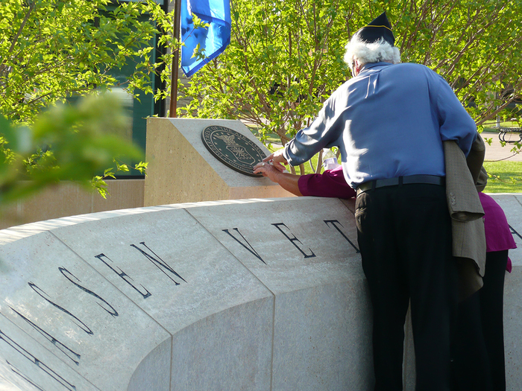
KELLY PTACEK
Veterans Memorial Chanhassen, MN

Slide 13
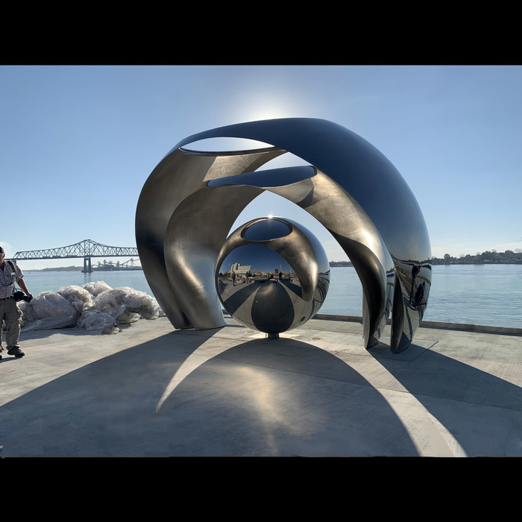
PO SHU WANG
Sing the River
Baton Rouge, LA

Slide 14
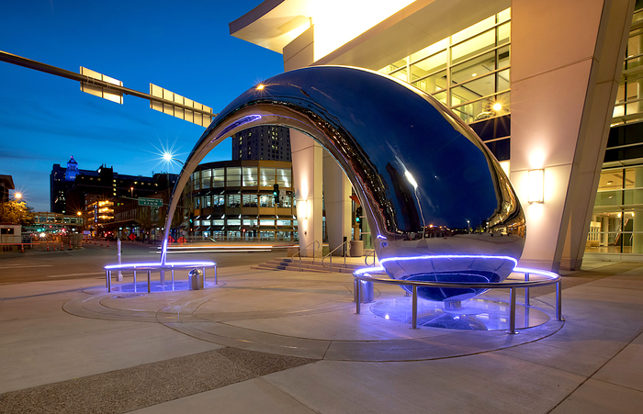
PO SHU WANG
Circumcenter
Rochester, MN

Slide 15
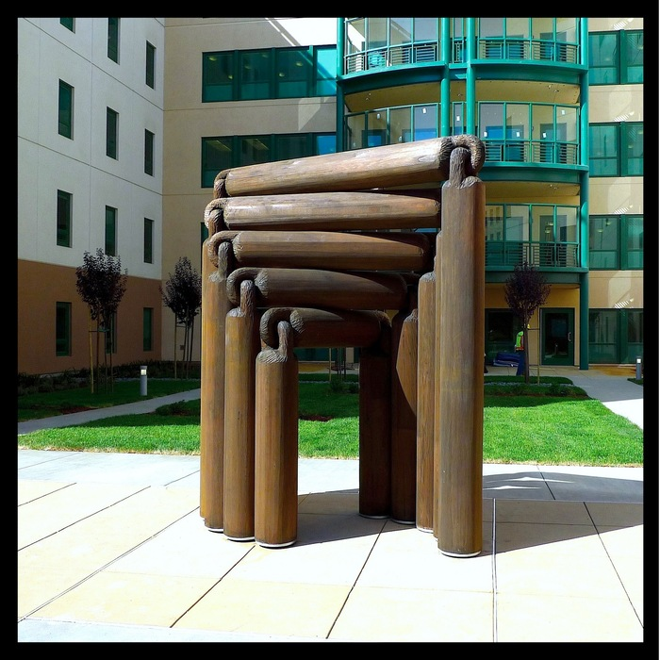
PO SHU WANG
Never Odd or Even
San Francisco, CA

Slide 16
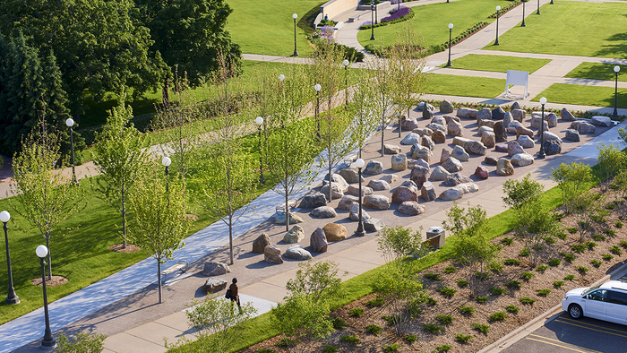
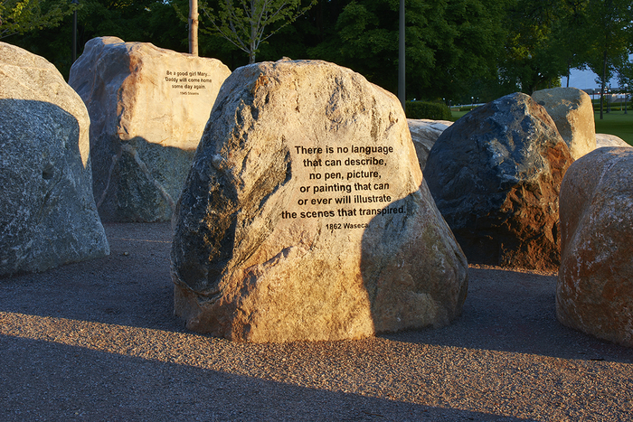
THEODORE LEE
Minnesota Military Family Tribute – Story Stones
St. Paul, MN

Slide 17
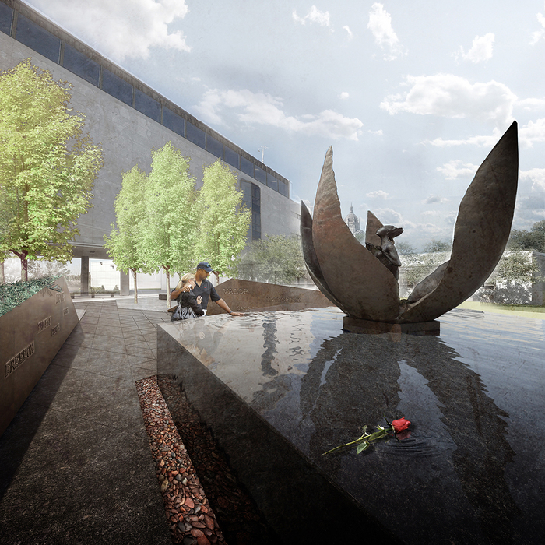
THEODORE LEE
Minnesota Medal of Honor Memorial St. Paul, MN

Slide 18
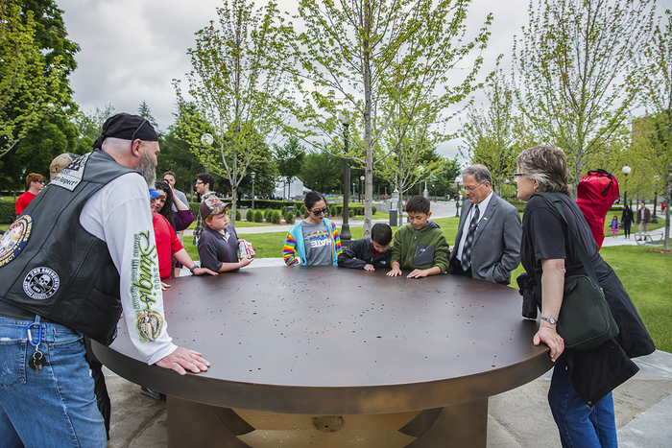
THEODORE LEE
Minnesota Military Family Tribute– Gold Star Table
St. Paul, MN

Slide 19
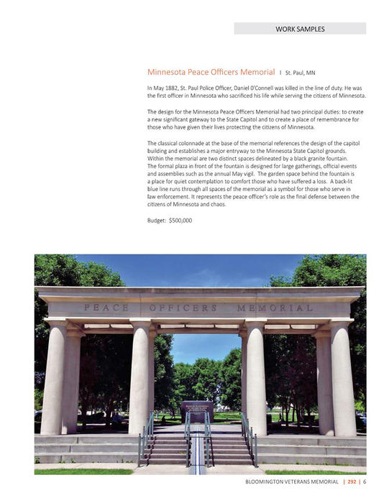
MARK WENTZELL
Minnesota Peace Officers Memorial
St. Paul, MN

Slide 20
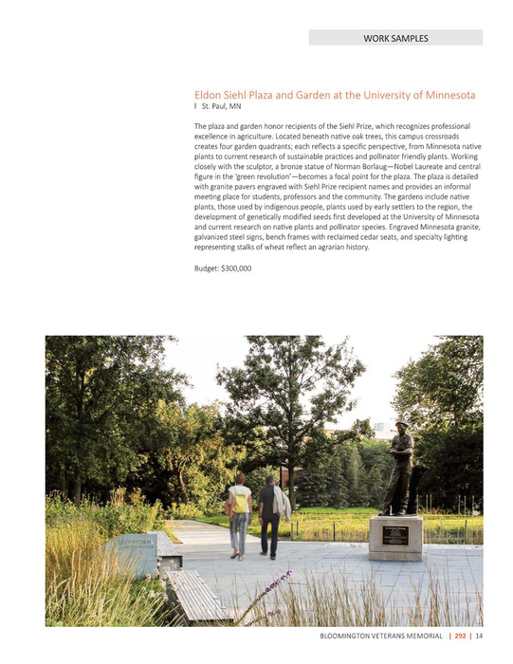
MARK WENTZELL
Eldon Siehl Plaza and Garden
University of Minnesota
St. Paul, MN

Slide 21
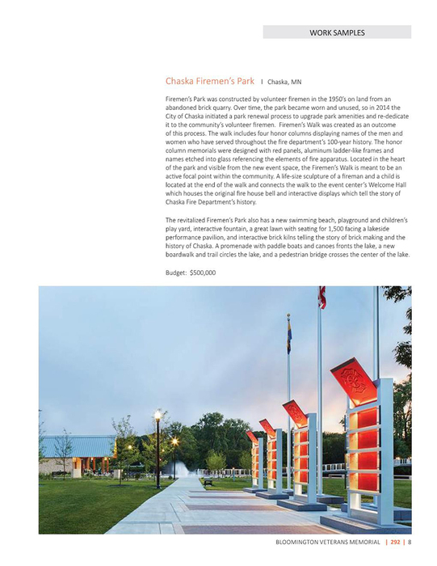
MARK WENTZELL Fireman’s Park
Chaska, MN

Slide 22
Next Steps
Selected Artists invited to submit a design proposal for a Veterans Memorial.
Artists interviewed week of October 26, 2020
  Panelists include:
  Alejandra Pelinka, Creative Placemaking Director
  Dave Hanson, Assistant Facilities Superintendent
  7 representatives from Bloomington Remembers Veterans, Inc.
Final Design Presented to City Council on November 9
Notes:
MELISSA
Thank you Mike.
The next steps are as follows: READ STEPS

Slide 23
Fundraising
The Veterans Memorial will be constructed through private fundraising by Bloomington Remembers Veterans Inc.
Financial contributions for the Veterans Memorial will be provided through donations from Bloomington Remembers Veterans Inc. to the City of Bloomington.
Ownership of the memorial will reside with the City of Bloomington.
Notes:
MELISSA
Bloomington Remembers Veterans has done some fundraising by attending community events including the Farmer’s Market, Heritage Days, and Veterans Appreciation Brunch.
Due to COVID 19 this has been paused and during this time, the board is finalizing their website, business plan, and creating a fundraising plan which will utilize the winning design. They recognize it will be more challenging due to the current economic situation, but are committed to this project.
The Board would like to reiterate that there is no request for City funds for this project.

Slide 24
Thank You
Questions?
Notes:
MELISSA
We are happy to answer any additional questions you have.
Thank you!

